Slide 1


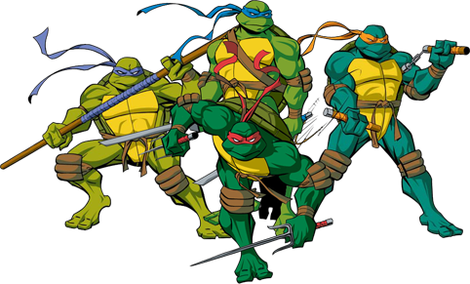
Applying Bloom’s taxonomy to the Teenage Mutant Ninja Turtles or
Where Krathwohl meets Krang

Slide 2
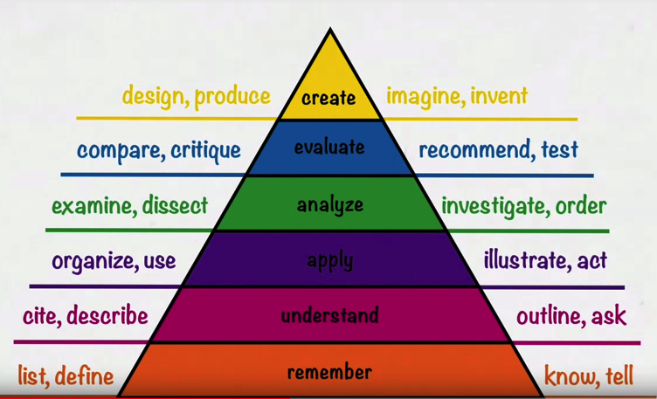
Bloom’s taxonomy (by Krathwohl)

Slide 3
Krathwohl’s four domains
Factual, Conceptual, Procedural, and Metacognitive
  I’m not sure these work for all levels (creating facts?)
However, Dettmer (2006) takes three established domains of learning:
  Cognitive (knowing stuff)
  Affective (values and so on)
  Psychomotor (skills)
and adds Social
  I think these are more useful

Slide 4
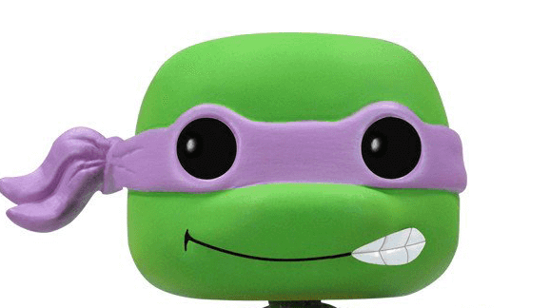
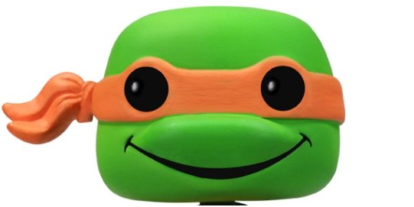
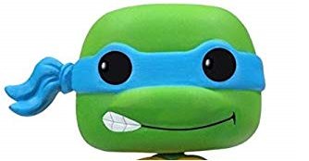
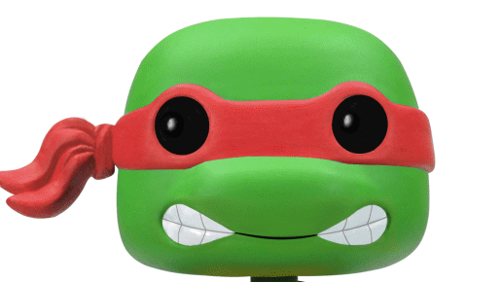
Mapping domains to turtles
The four ninja turtles are often mapped to the four temperaments, or humours
Donatello |  | Phlegmatic | Does machines
Raphael |  | Choleric | Cool but rude
Leonardo |  | Melancholic | Leads
Michelangelo |  | Sanguine | Is a party dude

Slide 5
Mapping domains to turtles
The four ninja turtles are often mapped to the four temperaments or humours
Donatello |  | Phlegmatic | Does machines | Cognitive domain
Raphael |  | Choleric | Cool but rude | Affective domain
Leonardo |  | Melancholic | Leads | Skills domain
Michelangelo |  | Sanguine | Is a party dude | Social domain

Slide 6
Using Blooms to develop activities
So … here’s the task. You’ve been asked to create a module teaching students about the Teenage Mutant Ninja Turtles, or alternatively we could look at the:
Adolescent Radioactive Black Belt Hamsters
Pre-Teen Dirty-Gene Kung Fu Kangaroos
Naive Inter-Dimensional Commando Koalas
Genetically Modified Punk Rock Pandas
Immature Radioactive Samurai Slugs
Adult Thermonuclear Samurai Pachyderms
Geriatric Gangrene Jujitsu Gerbils
Mildly Microwaved Pre-Pubescent Kung Fu Gophers

Slide 7
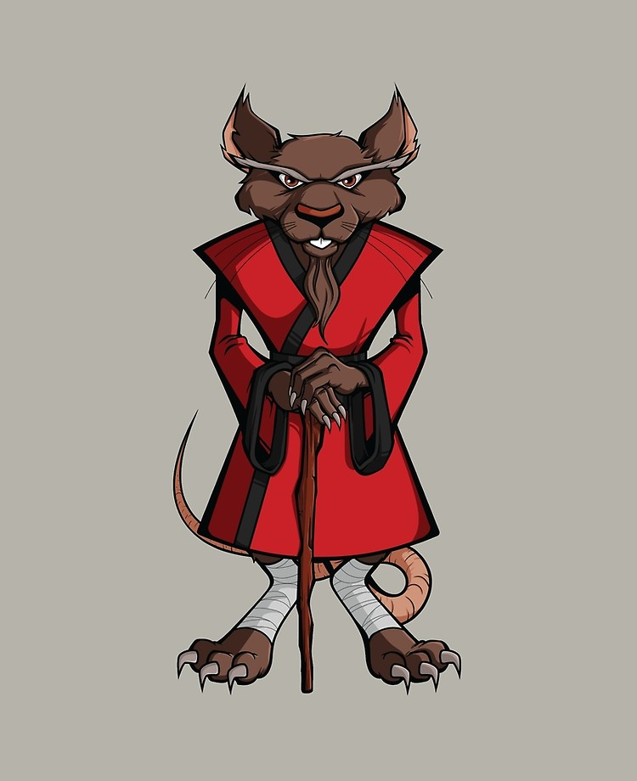
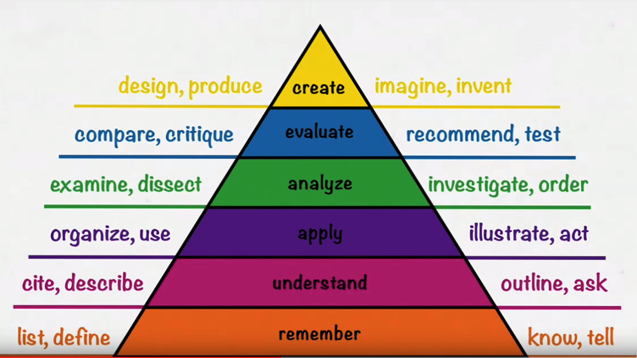
 | “Your mission is to create a series of learning activities building on Bloom’s taxonomy, using one or more of the different domains at each stage.” | Learning outcomes First: what kinds of attributes and skills should those who study the Turtles acquire? Then: Cognitive A series of tasks to starting with knowledge about the Teenage Mutant Ninja Turtles, through to students creating something.
Also consider: Social A series of tasks to develop their social skills. Affective Developing attitudes, values, awareness Skills Employability, professional, study skills
Using Blooms to develop activities

